Slide 1


Introduction to the licensed software portfolio
Attila Fekete

Slide 2






Currently on-going procurements
Ansys
Amber 22
SCM – Amsterdam Density Functional
CHARMM
Gaussian 16
Schrödinger Suite
TeraChem
Intel oneAPI HPC Toolkit
Matlab (through academic agreements)

Slide 3
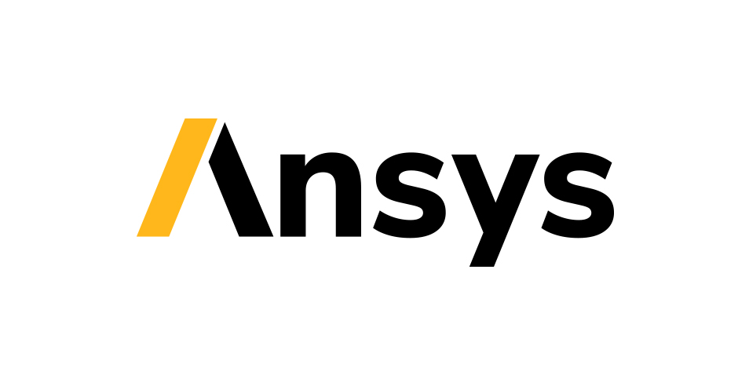






Ansys
Advanced engineering simulations
3D design, materials, structures
Autonomous Vehicle Simulation
Electronics, Optics, Photonics, Semiconductors
Fluids (CFD simulations)
License for 3 years – 256 core workgroup
25 research and 250 educational license

Slide 4
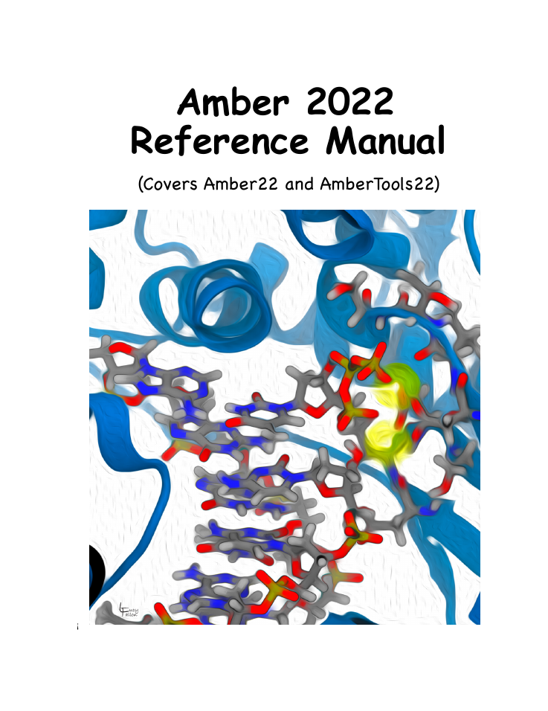
Amber22
„Fastest academic GPU MD simulation engine”
High level GPU utilization by pmemd (Legrand & Walker)
Advanced MD software for PB macromolecular simulations
Extensive analysis tools
Interfaces for many other softwares
Perpetual license

Slide 5


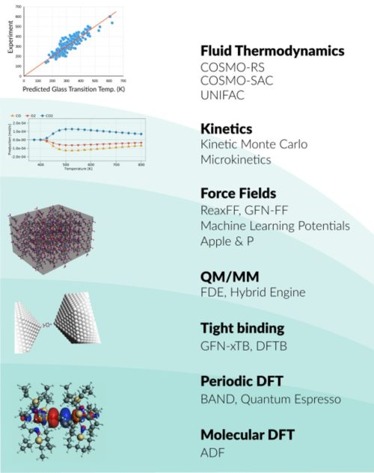
ADF (AMS2022)
„Fast and accurate density functional calculations”
ADF – DFT program for molecules, spectroscopy, inorganic chemistry
BAND – periodic DFT for condensed matter, incl. bulk, surfaces
COSMO-RS – fluid thermodynamics, property predictions from group contributions
DFTB – DF Tight Binding, fast approximate DFT for 1D, 2D, 3D
ReaxFF – Reactive FF for large-scale MD simulations w/chem. Reactions
MLPlot – Machine Learning Potential backend for PES tasks
3-year „old-style” full bundle for unlimited cores incl. new releases

Slide 6
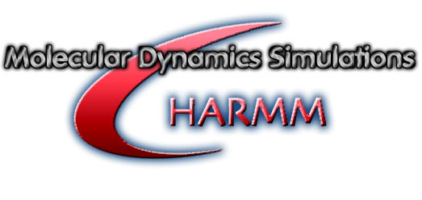
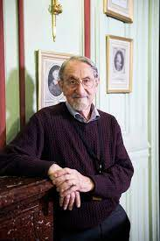
CHARMM
Swiss army-knife of MD suites, led by Martin Karplus
Enhanced sampling methods
Multi-scale techniques (QM/MM, MM/CG)
Simulations of biological systems in solution, crystal and membrane
Analysis and model building tools
Parallel cluster and GPU support
Perpetual license

Slide 7

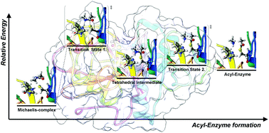
Gaussian16
The most cited quantum chemistry software
Easy to use & robust
Hartree-Fock, (TD-)DFT, post-HF & semiempirical methods
Solvation models, spectroscopy
Hybrid methods by ONIOM (QM/QM, QM/MM, QM/QM/MM)
Partial GPU support
Perpetual license

Slide 8

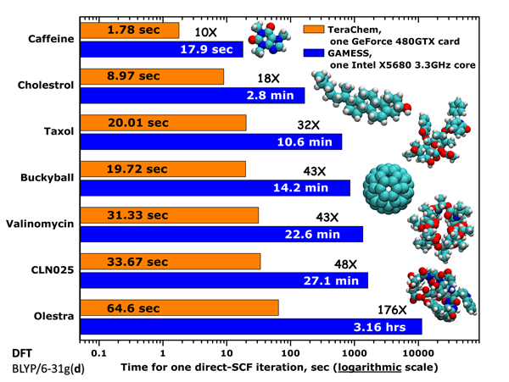
TeraChem
General purpose QC software designed to run on nVidia GPUs
HF & grid-based Kohn-Sham energy and gradient calcs.
Various DFTs, incl. long-range corrected & Coulomb attenuated
TD-DFT and CIS
Geometry optimizations (L-BFGS, conjugate gradient, SD)
Ab initio MD (NVE, NVT ensembles)
Multi-GPU support, single/dynamic/double precision
1-year license

Slide 9
Schrödinger suite
From drug discovery to material science and for everything in between
Interchangeable token library (50 tokens)
Basic - AutoQSAR, MacroModel, Epik, Jaguar, Canvas, Qsite
Ligand- & structure-based – (Phase, Shape screening, Field-based QSAR, Glide, Prime, Core hopping, Prime X
Desmond GPU – 10 floating liceneses
OPLS FF – 1 access license
Add-on floating licenses (20) – Glide, Prime, Phase, Jaguar, QSite
3-year license for academic use

Slide 10
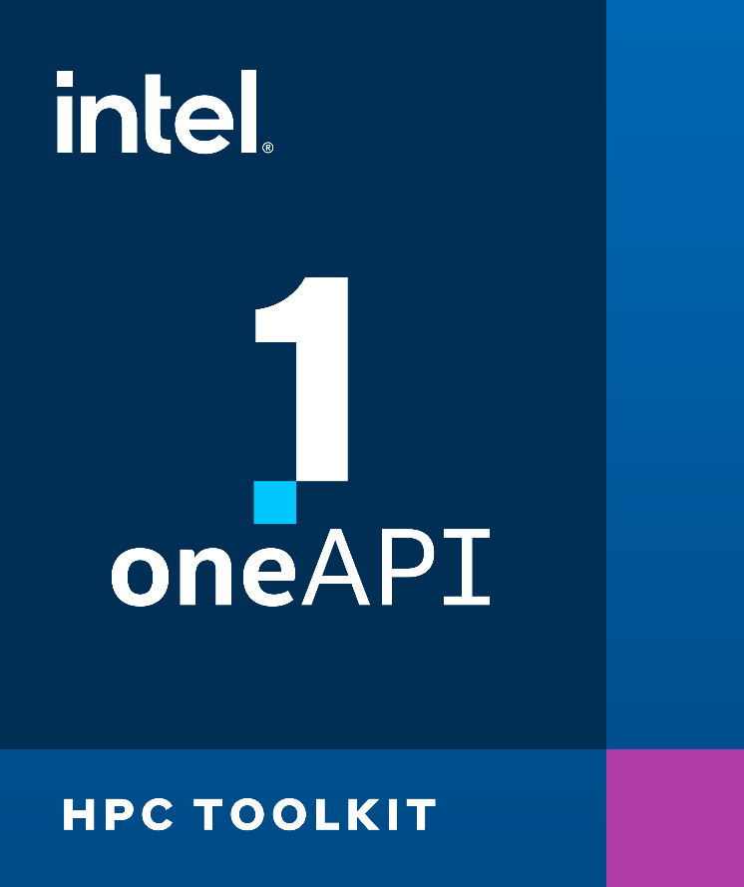
Intel oneAPI HPC Toolkit
DPC++/C++ compiler
C++ compiler classic
Cluster checker
Fortran compiler
Intel Inspector
MPI library
Trace analyzer & collector
2 concurrent user, multi-node – 3-year

Slide 11

TotalView
The most advanced debugger for HPC
Simplify HPC debugging
Streamline GPU debugging
Improve insight and control
Increase efficiency
Debug code in multiple languages
Simplify new platform adoptation
3-year license, 8 token

Slide 12

Matlab
Through hosting provider agreements with universities
Data analysis, Graphics (data visualization)
Programming
App building & external language interfaces
Hardware and parallel computing

Slide 13






Thanks for your attention!

