Slide 1

Introduction to Komondor
National HPC development
Zoltan Kiss, Head of HPC Dpt.
KIFÜ

Slide 2

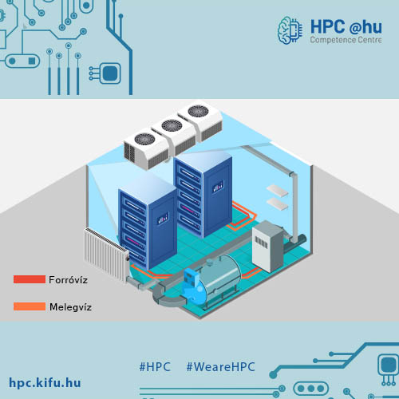


Contents
HPC Competence Centre
IT development
HPC infrastructure
Portals
EuroHPC

Slide 3







HPC ecosystem
Competence Centre and SME relations
Infrastructure development

Slide 4
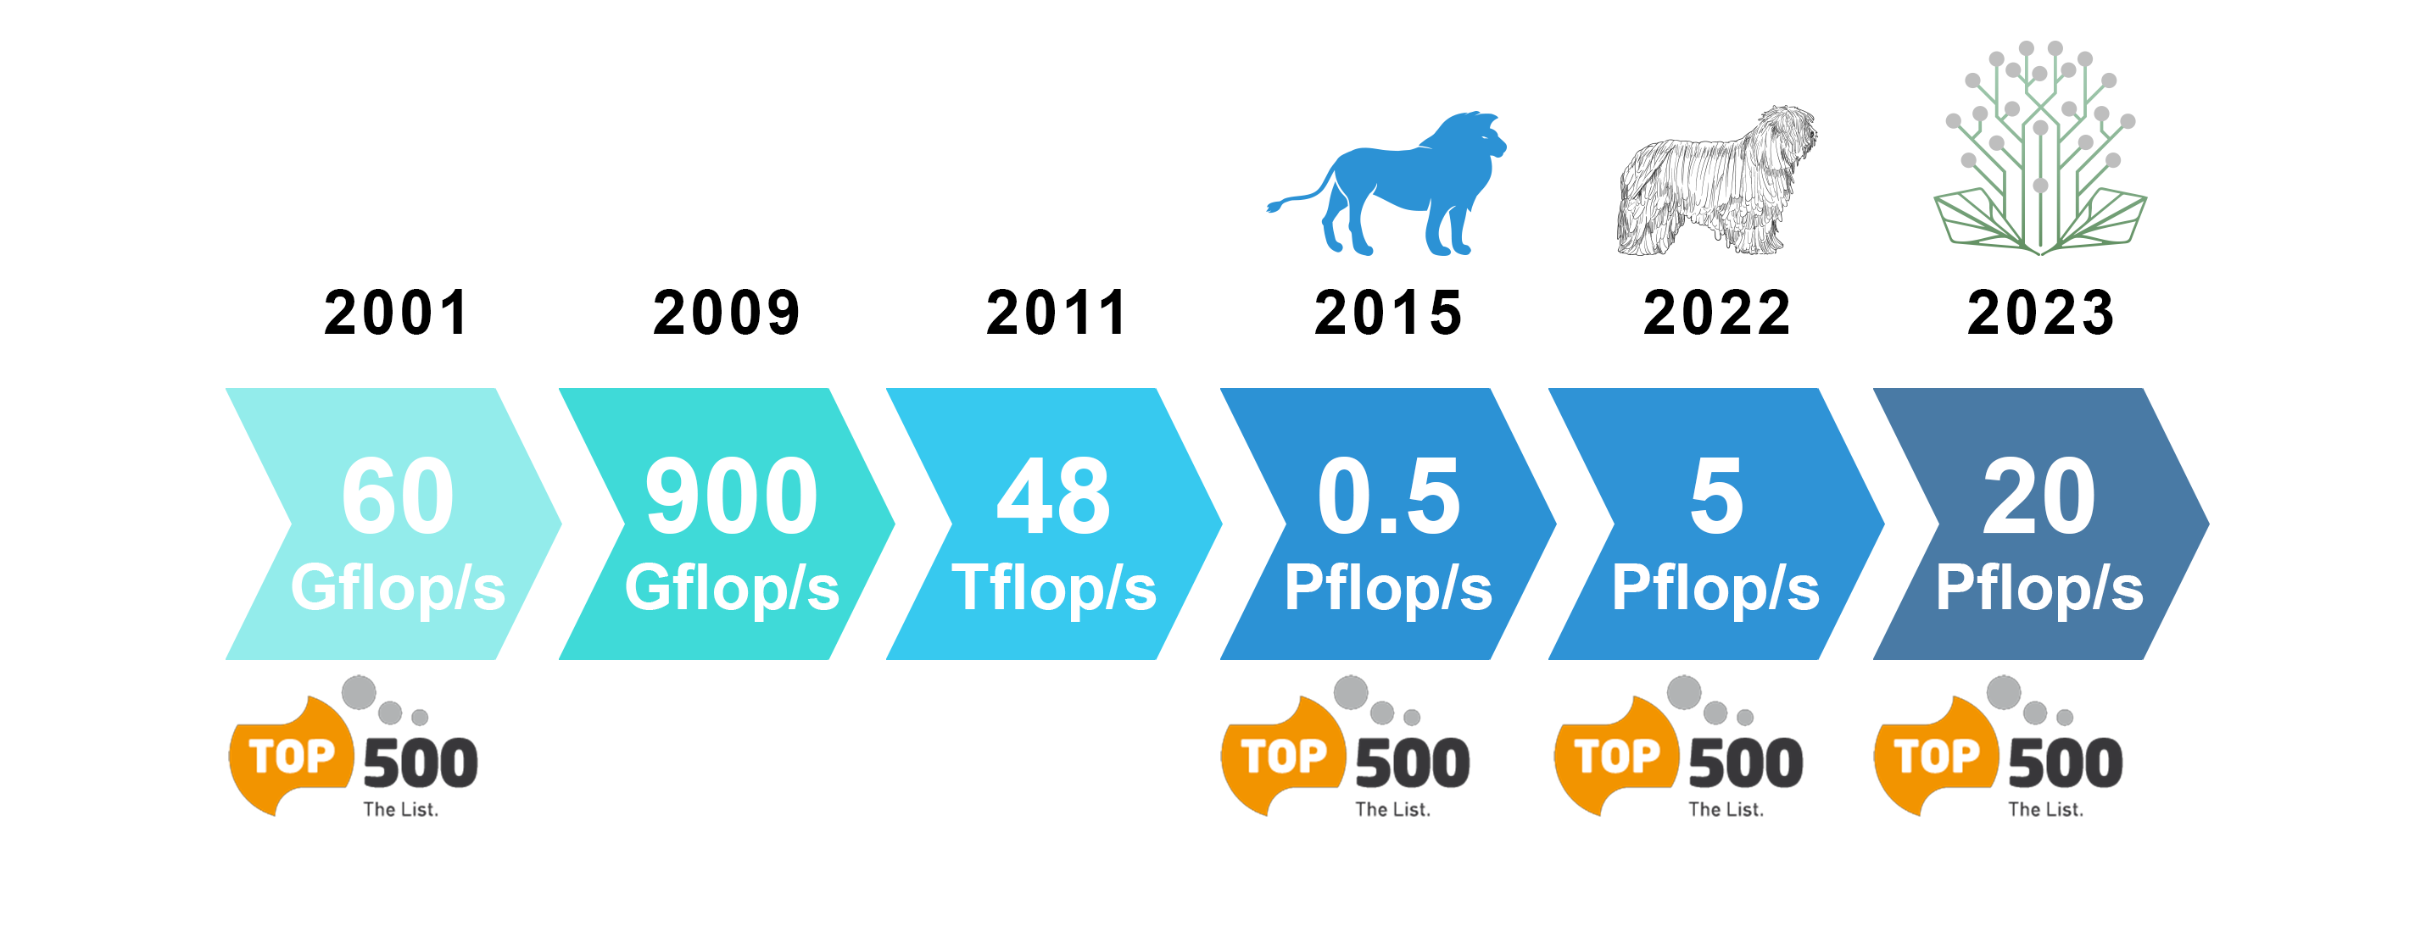
20 years of Hungarian HPC

Slide 5


Infrastructure development
Hardware
Software

Slide 6
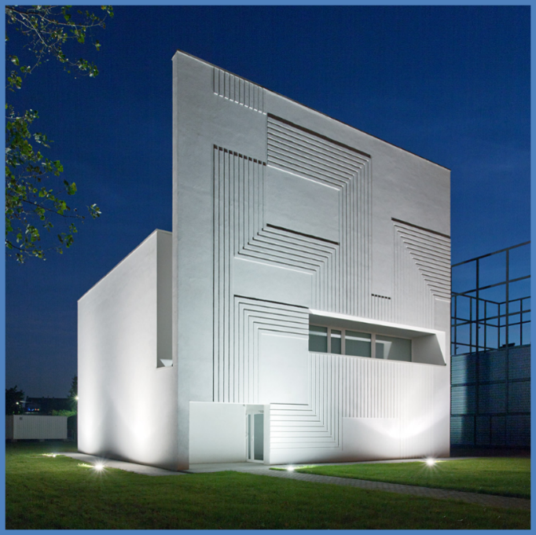
Green DC
Hot water used
90% air cooled
2022 Q3 – 5+ PF HPC
Efficiency
Extreme density
Award winning building designer
In Debrecen Campus

Slide 7
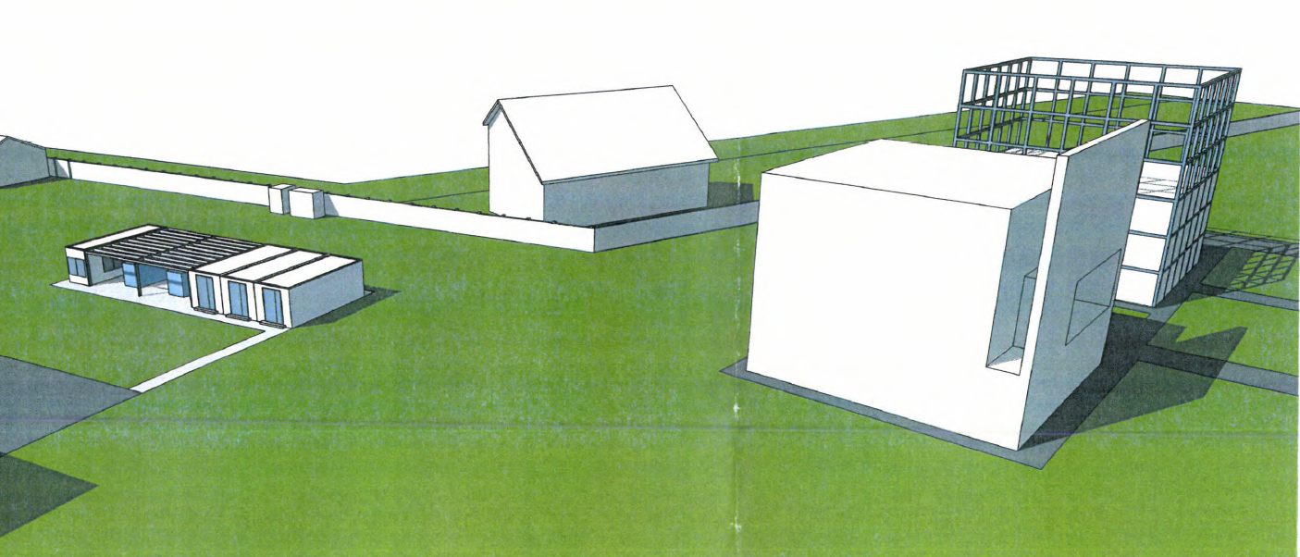

Slide 8
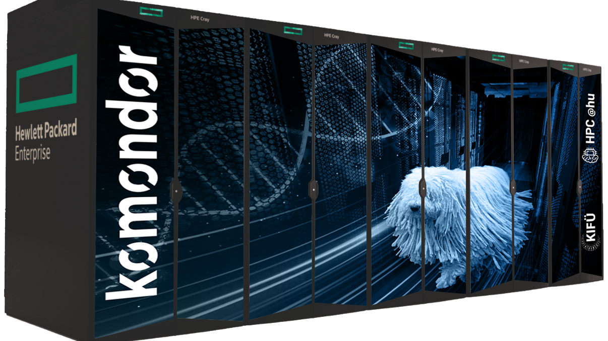
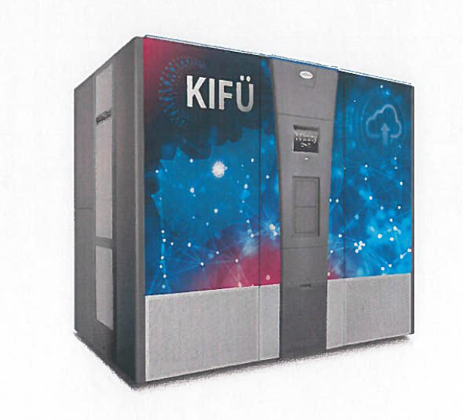
Komondor

Slide 9
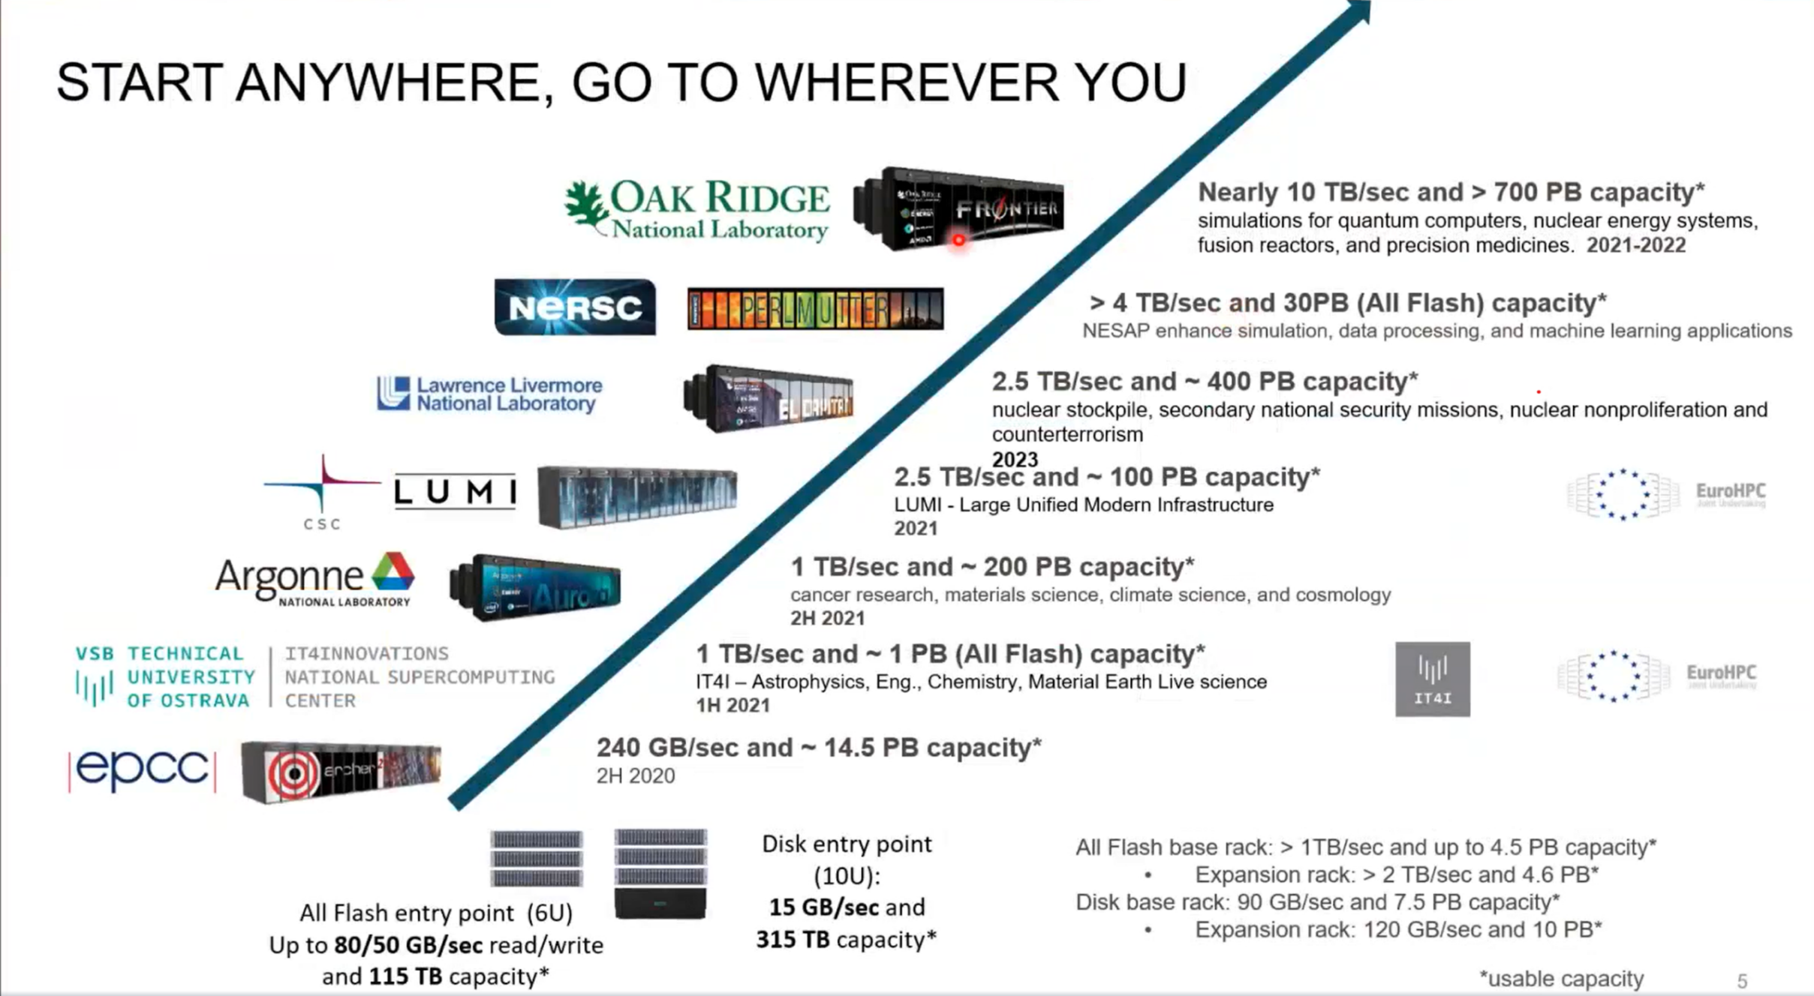

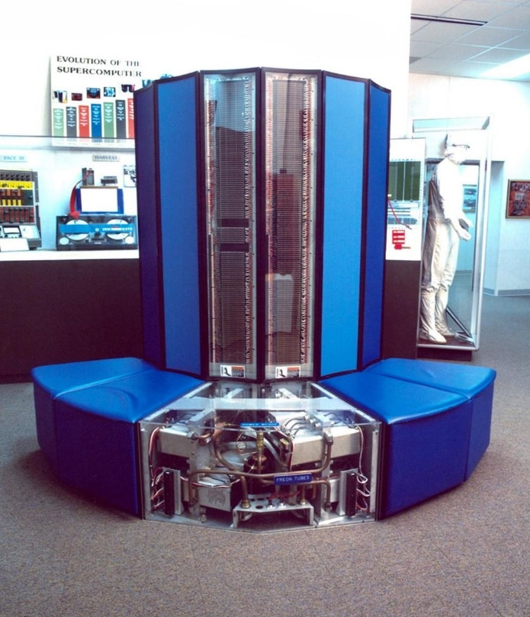

CRAY EX EXASCALE INFARSTRUCTURE
1.5 ExaFlops (US)
65 Pflops (US)
2 ExaFlops (US)
550 Pflops (EU)
180 Pflops (US)

Slide 10



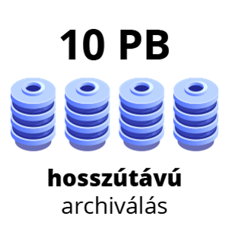


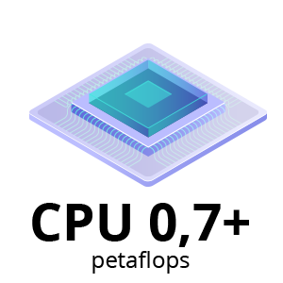
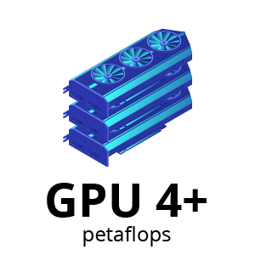
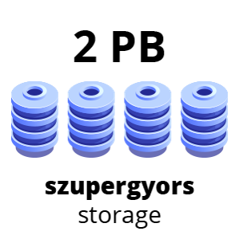
20 000+ CPU mag, 200+ GPU
GPU 4+ PF
CPU 0,7+ PF
Big Data 9+ TB memória
MI partíció 8 GPU/node
2 PB szupergyors storage + 10 PB tape
Tape archive
memory
Ultrafast
CPU
GPU
BIG DATA
MI
STORAGE

Slide 11
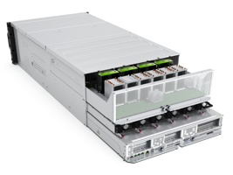
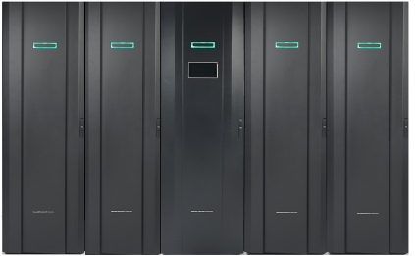
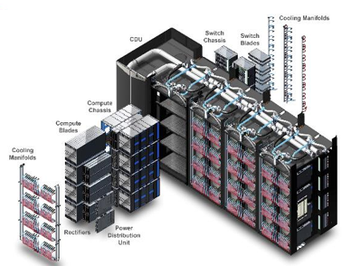
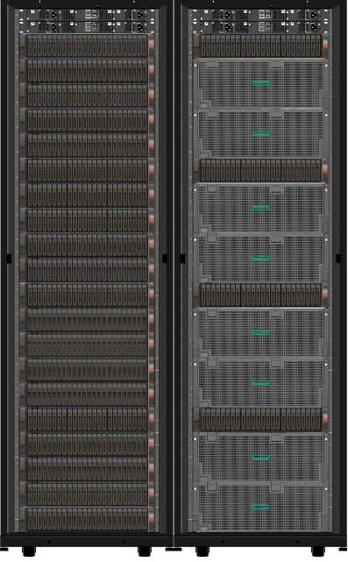
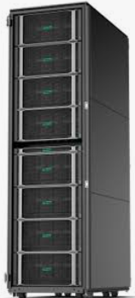
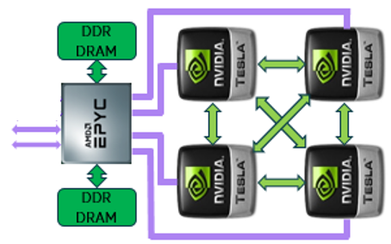
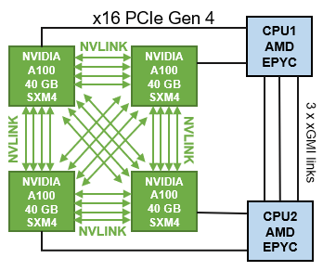

Slide 12
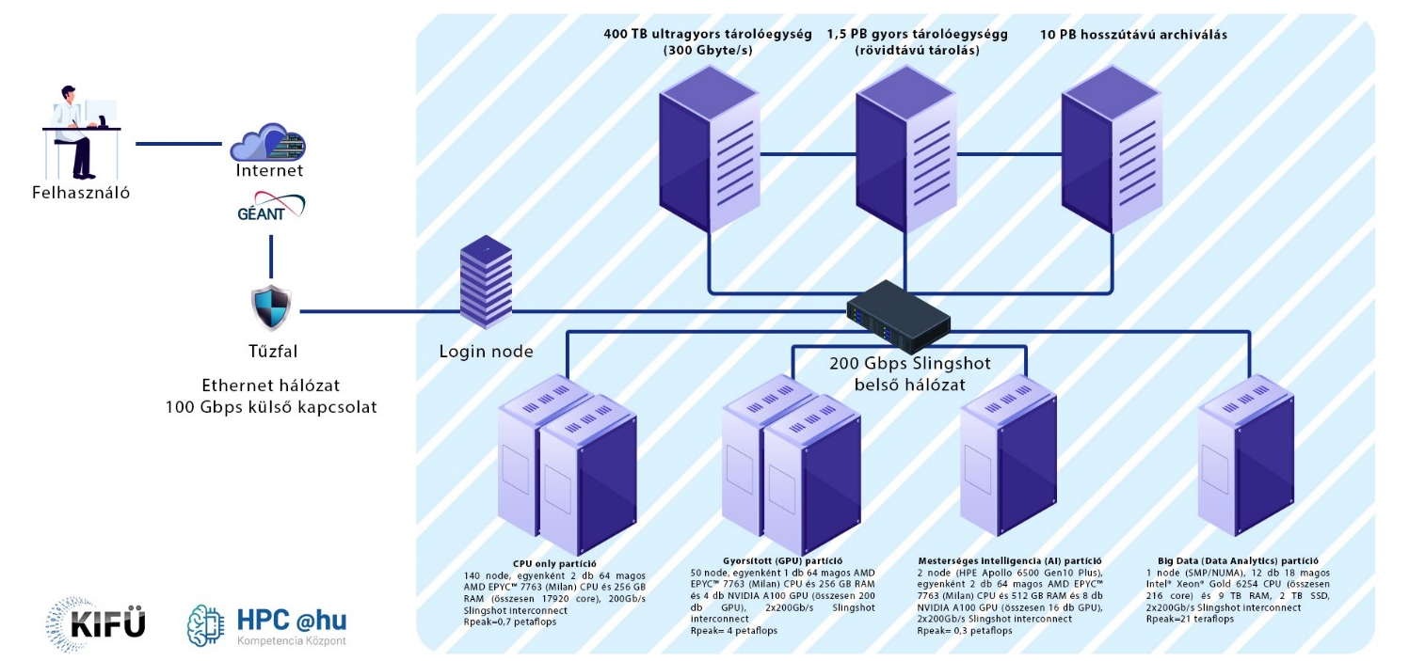

Slide 13
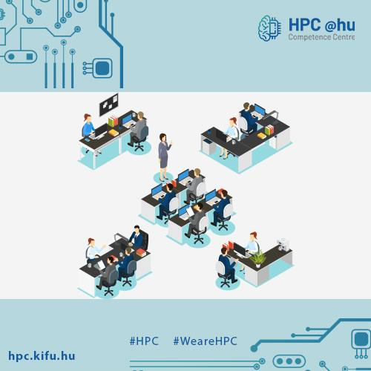
Software
Ansys
Amber20
Amsterdam Density Functional (ADF)
CharMM
Gaussian 16
Terachem
Schrödinger
TotalView

Slide 14
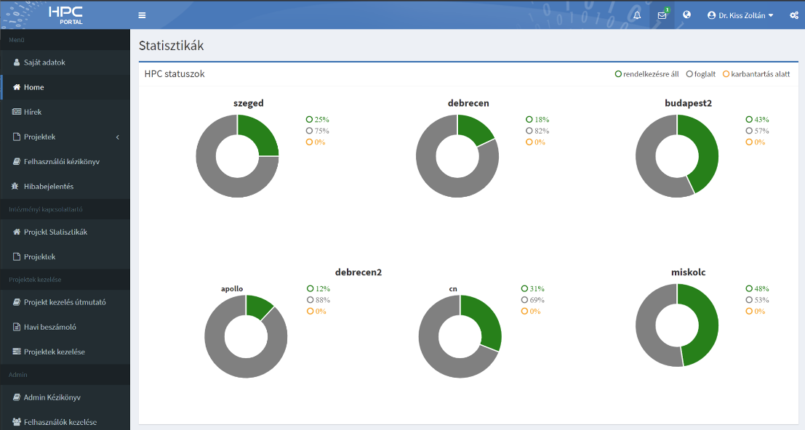



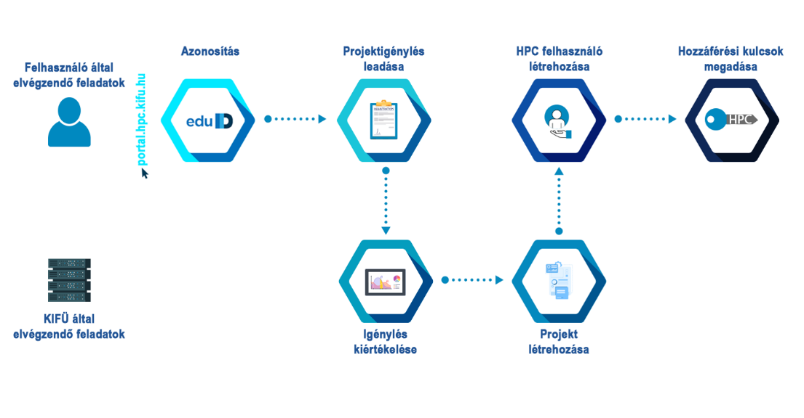

HPC portal
What could go wrong?

Slide 15
Deploy workflow - example
CKAN
CI
Containers
Visualization

Slide 16

EuroHPC tender (2023)
20 PF
CPU + GPU + Big Data + MI
Multilevel storage system
Visualization subsystem
Modular arhictecture
Quantum HPC integration
HU-DE (Juelich – ITM – KIFÜ) cooperation
Portal and software developments

Slide 17




Thank you for your feedback!
hpc.kifu.hu
kiss.zoltan@kifu.gov.hu
@HPC.CC.hu
@HPC_hu

